Slide 1
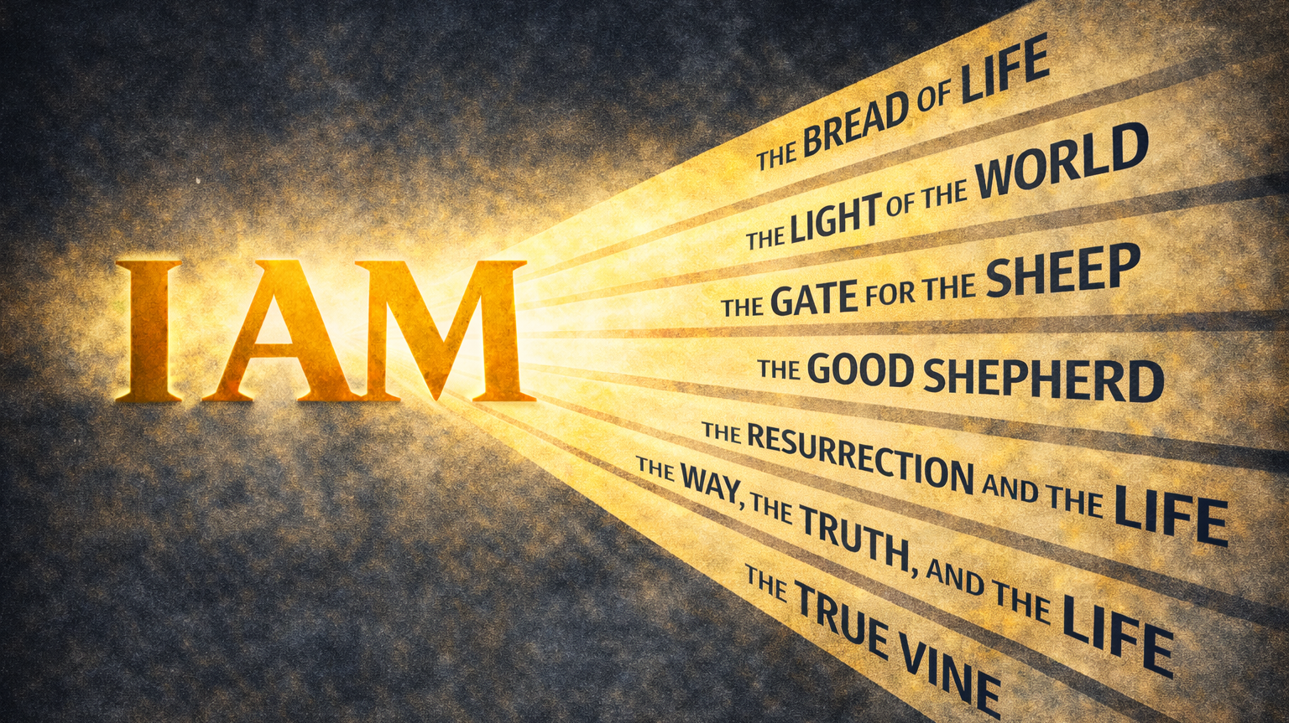
WEEK 6

Slide 2
A disciple will bear fruit.
The True Vine

Slide 3
“God said to Moses,
‘I AM WHO I AM.
This is what you are to say to the Israelites:
‘I AM has sent me to you’”
Exodus 3:14

Slide 4
FALLEN CONDITION FOCUS
We are prone to live as though life and fruit can be sustained apart from ongoing connection to Christ. Even when we believe in Jesus, we drift toward independence, relying on effort, habit, or experience rather than dependence. In doing so, we attempt to bear fruit without remaining attached to the only source of life.
GOSPEL RESPONSE
The good news is that Jesus does not call us to produce life on our own but to receive His. He offers Himself as the source of life, inviting us into a relationship where fruit flows from connection rather than effort. What we cannot generate through discipline or resolve, Christ freely supplies through union with Him.

Slide 5
HOW DO WE RESPOND
Question 1: Which words or images from John 15:1–5 felt most noticeable or memorable to you, and what do you think made them stand out?
Question 2: Jesus stated that fruit comes from staying connected to Him, not from effort alone. Where do you notice yourself focusing more on outcomes than on connection right now?
Question 3: Jesus said a branch cannot bear fruit by itself. What does trying to carry life or growth on your own look like in everyday terms for you?
Question 4: What practices or rhythms help you stay aware of your connection to Jesus during ordinary, unremarkable weeks?
Question 5: If remaining in Jesus is the source of fruit, how might our group help one another stay connected rather than measure one another by visible success or spiritual progress?

