Slide 1
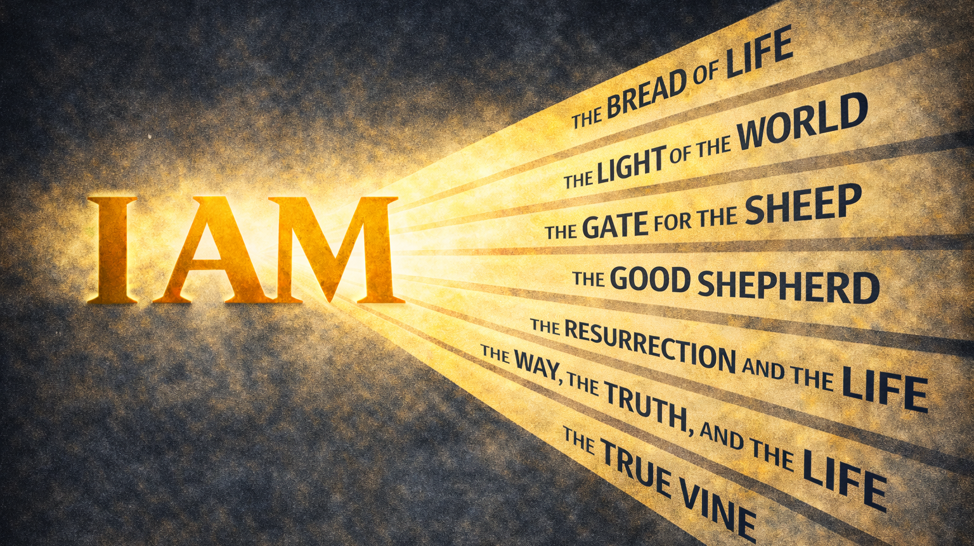
WEEK 4

Slide 2
A disciple believes Jesus gives life.
The Resurrection and the Life

Slide 3
“God said to Moses,
‘I AM WHO I AM.
This is what you are to say to the Israelites:
‘I AM has sent me to you’”
Exodus 3:14

Slide 4
FALLEN CONDITION FOCUS
We die. Every life moves in that direction, and nothing we do stops it in the end. We can delay it, distract ourselves from it, or refuse to think about it, but death remains unavoidable. We cannot generate life ourselves. Our eternity depends on a Life Giver.
GOSPEL RESPONSE
Because Jesus is life and resurrection, death no longer gets the last word. This isn’t an escape from death but a defeat of it. By His own death and resurrection, Jesus made death a passage rather than an ending. For those who belong to Him, death may still come, but it no longer has finality.

Slide 5
HOW DO WE RESPOND
Question 1: As you read John 11:17–27, what part of the conversation between Jesus and Martha did you find yourself lingering over? Was there a statement or exchange that felt especially significant or unexpected?
Question 2: Martha believed in resurrection, but she placed it at the end, not in the present. Where in your life are you most tempted to believe God can act someday without expecting Him to meet you now?
Question 3: Jesus did not deny that death happens, but He challenged what death is allowed to decide. Where have you accepted an ending as final and stopped expecting anything more?
Question 4: Jesus asked Martha, “Do you believe this?” not as a test of knowledge but as a personal question. Where does your faith tend to stay true but abstract, affirmed without shaping how you face loss or uncertainty?
Question 5: This passage does not rush resolution. How can our group help one another acknowledge grief and loss while still holding onto Jesus’s claim about life experienced in the present? How do we grieve as those who have hope?

