Slide 1
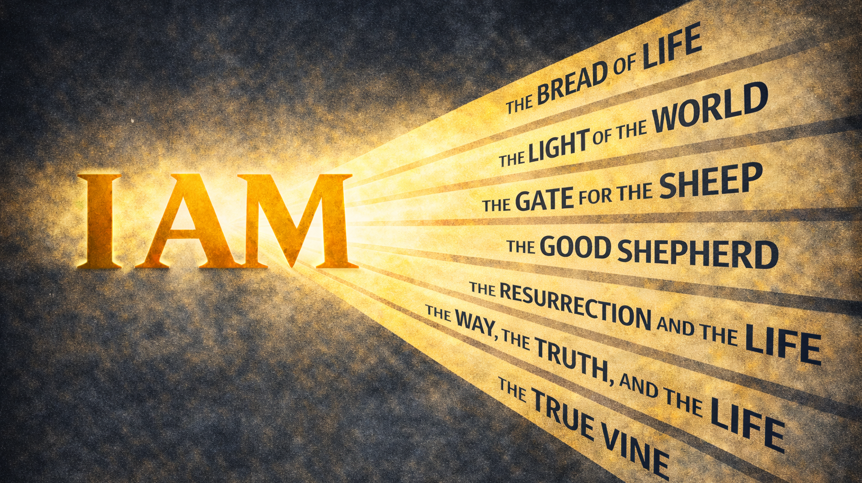
WEEK 3

Slide 2
A disciple is shepherded by Jesus
The Gate and
The Good Shepherd

Slide 3
“God said to Moses,
‘I AM WHO I AM.
This is what you are to say to the Israelites:
‘I AM has sent me to you’”
Exodus 3:14

Slide 4
FALLEN CONDITION FOCUS
We like to imagine ourselves as capable caretakers, but when pressure rises, we are far less faithful than we think. Faced with risk, fatigue, or inconvenience, we pull back, protect ourselves, and leave exposed what was entrusted to us. Sin shows itself not only in following the wrong voices but in our quiet willingness to abandon responsibility when care becomes costly.
GOSPEL RESPONSE
Jesus did not relate to us as a reluctant caretaker or a hired hand. He named Himself as the Good Shepherd who stays, who watches, and who places Himself between His sheep and danger. Where we withdraw and abandon responsibility, He remains present, even to the point of laying down His life for those who belong to Him.

Slide 5
HOW DO WE RESPOND
Question 1: As you reflect on John 10:7–18, what stood out to you most? Was there a word, image, or contrast that felt especially weighty or surprising?
Question 2: Jesus described Himself as both the gate and the shepherd. Where in your life right now do you most want protection, care, or assurance that someone is truly watching over you?
Question 3: Jesus contrasted the good shepherd with the hired hand who left when danger appeared. When responsibility becomes costly or uncomfortable, what is your natural tendency? Is it to stay engaged or to pull back?
Question 4: Jesus said His sheep know His voice and trust Him. What voices most shape your sense of direction right now? How do you tell the difference between voices that truly care for you and those that simply demand something from you?
Question 5: If trusting Jesus as the Good Shepherd means staying close to Him rather than relying on your own awareness, what is one small, concrete way you could practice that this week? How could our group support you in that step?

