Slide 1
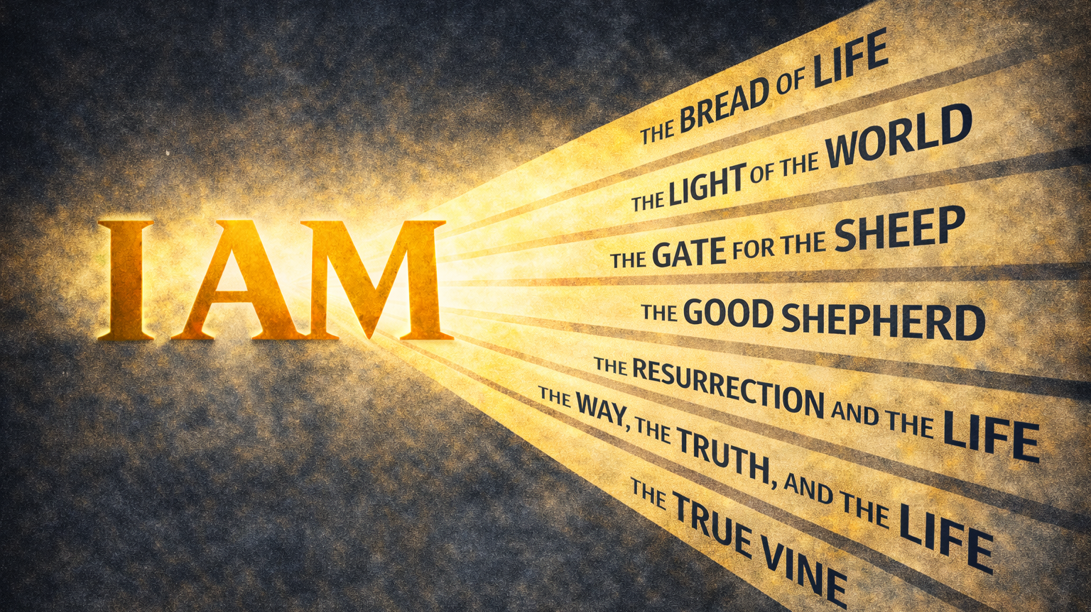
WEEK 5

Slide 2
A disciple believes Jesus is the way to God.
The Way, the Truth, and the Life

Slide 3
“God said to Moses,
‘I AM WHO I AM.
This is what you are to say to the Israelites:
‘I AM has sent me to you’”
Exodus 3:14

Slide 4
FALLEN CONDITION FOCUS
Because access to God has been broken, we spend our lives searching for a way back. We rely on methods, morality, and meaning-making to bridge the gap, but none of them can restore what has been lost. We cannot know God or know about God without a mediator.
GOSPEL RESPONSE
God does not leave us to search for a way back to Him. We cannot restore through effort, morality, or understanding what God provides through Jesus Christ. Jesus did not offer a method for reaching God or a set of truths to master. He presented Himself as the way. The access to God that was lost through sin was restored through a mediator God Himself provided. To know Jesus is to know the Father, because Jesus stands between humanity and God as the true and sufficient way back into His presence.

Slide 5
HOW DO WE RESPOND
Question 1: Which of Jesus’s words in John 14:1–7 felt most personal or relevant to where you are right now?
Question 2: Jesus told His disciples not to let their hearts be troubled, and then immediately called them to trust Him. Where do you notice troubled thoughts or restlessness shaping your decisions right now?
Question 3: Jesus said no one comes to the Father except through Him. Where are you most tempted to look for guidance, security, or meaning apart from Him?
Question 4: Jesus linked knowing Him with knowing the Father. What does it look like to know about God without really knowing Him?
Question 5: If trusting Jesus as the way means releasing the need to manage access to God on your own, what is one small step of trust you could practice this week? How could our group walk with you in that?

