Slide 1
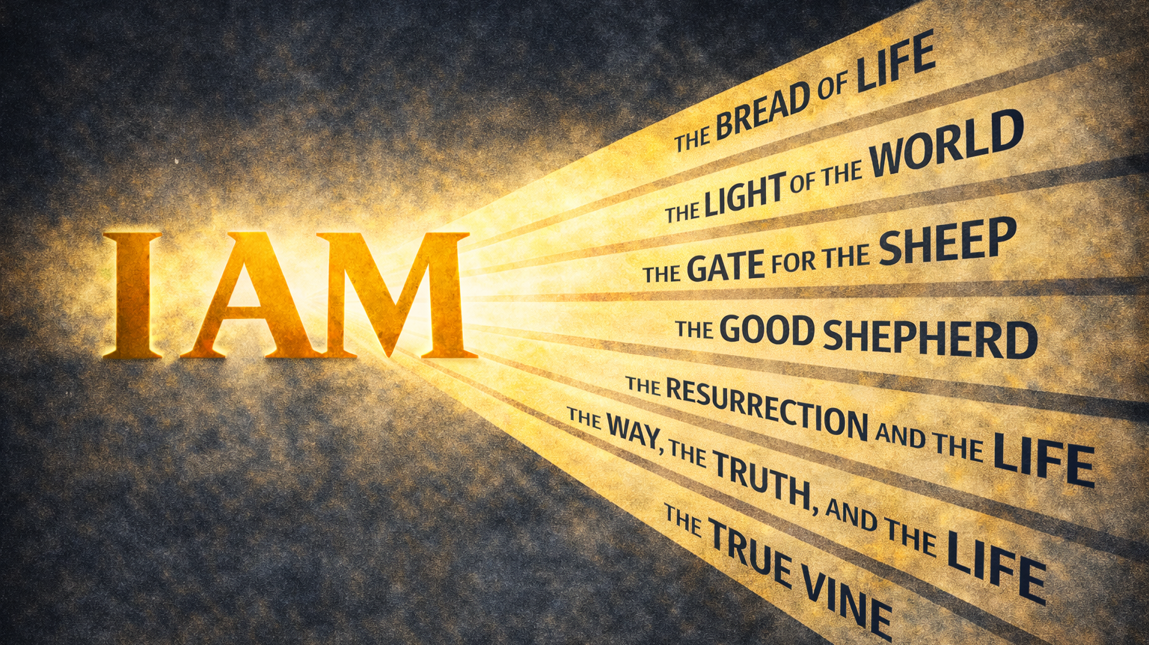
WEEK 2

Slide 2
A disciple believes Jesus is our light for salvation
The Light of the World

Slide 3
“God said to Moses,
‘I AM WHO I AM.
This is what you are to say to the Israelites:
‘I AM has sent me to you’”
Exodus 3:14

Slide 4
FALLEN CONDITION FOCUS
Irreligious people live in darkness. Their vision is darkened and they turn to all sorts of things (idols) looking for direction and satisfaction. Left to ourselves, we trust our own sense of sight and judgment, even when it is limited or distorted. We confuse confidence with clarity and manage darkness rather than confront it. This leaves us vulnerable to self-deception and resistant to any light that challenges how we see ourselves and the world. Religious people often find safety in established “rules” of Christianity, but they miss the person, Jesus Christ, the Light.
GOSPEL RESPONSE
God does not leave us to navigate the darkness on our own. Rather than offering clearer rules or better techniques for seeing, He gives Himself. In Jesus, God stepped directly into the world and made His guidance personal and present. The gospel announces that clarity does not come from trusting ourselves more deeply. It comes from following the One who sees truly and leads faithfully even when we do not yet understand the path ahead.

Slide 5
HOW DO WE RESPOND
Question 1: As you read through John 8:12–20, what stood out to you most? Was there anything specific that felt challenging, unsettling, or clarifying?
Question 2: Jesus described Himself as light for those who are walking in darkness. Where in your life do you feel stuck, unsure, or unclear about direction right now? How can you follow Jesus in these areas and fight self-sufficiency?
Question 3: The Pharisees responded to Jesus by questioning His authority instead of examining themselves. When you feel challenged or exposed, what is your usual instinctive response?
Question 4: Jesus linked knowing Him with knowing the Father. Where do you find it tempting to rely on your own judgment, experience, or understanding instead of allowing Jesus to define what is true?
Question 5: If following Jesus means allowing His light to guide your steps, what is one small, concrete way you could practice that this week? How could our group walk alongside you in that?

